Slide 1


FUEL
CONSUMPTION
PREDICTION
ML GROUP-12

Slide 2




Team Presentation
Abhishek Pandey PTDA16_179
Sanjeev Vishwakarma
PTDA16_245
Simran Raghuvansh PTDA15_227
Vaibhav Jadhav PTDA16_118

Slide 3
Table of contents
1
2
3
Regression Introduction
Approach
EDA Analysis
4
5
Challenges
and
Learning
6
Model
Deployment
Insights

Slide 4

Regression Analysis

Slide 5
Why Regression Analysis ?
A set of statistical process for estimation the relationships between a dependent variable (‘outcome’ or ‘response’) and one or more independent variables (‘predictors’ , ‘covariates’ , ‘explanatory variable’ or ‘features’).

Slide 6

Types of Regression
01
02
03
04
Linear Regression
Decision Tree Regression
Random Forest Regression
Polynomial Regression
Notes:
https://storyset.com/amico

Slide 7

Fuel Consumption Prediction

Slide 8






Libraries
Required
Pandas
Numpy
Matplotlib
Seaborn
Scikit-Learn

Slide 9







Approach
Study the Problem Statement
Importing Dataset
Data
Cleaning
removing
unwanted
data
EDA
(Exploratory
Data Analysis)
Data
Visuali-
sation
Data
Pre-
processing
for
prediction
Predictive
Model
Deployment
Notes:
Photo by Firmbee.com on Unsplash

Slide 10
Analysis Part Prior Making Model
This analysis is performed on Tableau Dashboard
ML_PROJECT_final | Tableau Public

Slide 11


Exploratory Data Analysis
(EDA)
Notes:
Photo by Kelly Sikkema on Unsplash

Slide 12
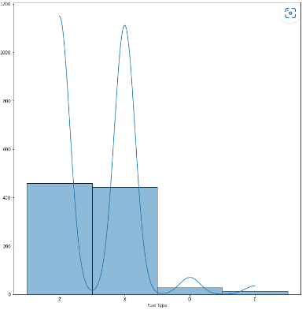
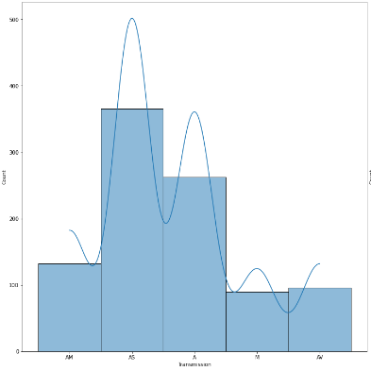
EDA - Univariate Analysis
1
1
Frequency
Distribution
For
Category
Features

Slide 13
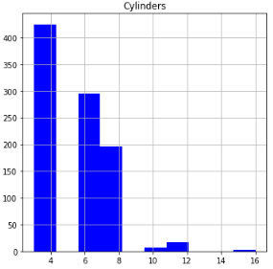
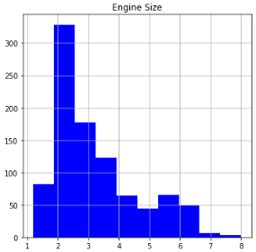
EDA - Univariate Analysis
2
1
Frequency
Distribution
For
Numerical
Features

Slide 14
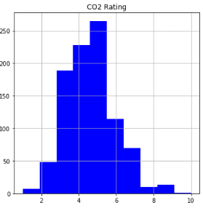
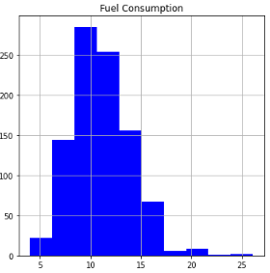
EDA - Univariate Analysis
2
1
Frequency
Distribution
For
Numerical
Features

Slide 15
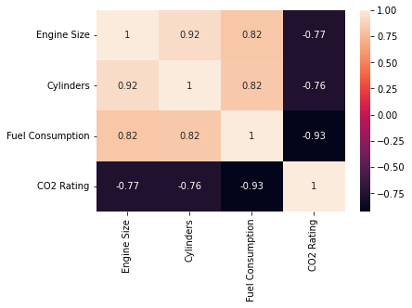
EDA - Bivariate Analysis
HEAT-MAP :
Pearson
Correlation

Slide 16
EDA - Bivariate Analysis
Transmission & Fuel type
CHI-SQUARE
Analysis
Transmission & Vehicle Class
P-Value : 3.762904200e-41
Dependent
D.O.F is 12
P - SCORE VALUE < 0.05 ,
Features are dependent on eacg other
P-Value : 3.356375805e-79
Dependent
D.O.F is 52

Slide 17
Models Scores Value
Random
Forest
Model
Decision Tree Model
Polynomial
Model
04
LInear Model
03
r2-score
02
r2-score
01
r2-score
94.43%
r2-score
94.02%
2 deg. 93.30%
92.61%
3 deg. 91.87%
Notes:
https://storyset.com/amico

Slide 18
INSIGHTS

Slide 19
Key Insights
Best Model Selection (through Ordinal Encoding).
Based on their respective P-score, Transmission has a higher dependency on vehicle class then fuel type.
Correlation analysis indicates, strong relationship b/w fuel consumption and CO2 rating followed by cylinder and engine size.
Number of Cylinders Increases Fuel consumption also increases.

Slide 20
Model Deployment
Selecting the best model for local host deployment can be challenging when scores are comparable, but after evaluating optimal approaches, Random Forest Regression was concluded as the most suitable choice.

Slide 21
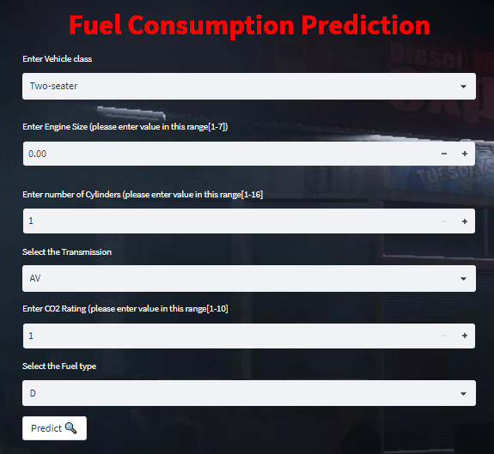
Model
Deployment
HomePage
Before
Input
https://fuel-consumption-ratings.streamlit.app/#fuel-consumption-prediction

Slide 22
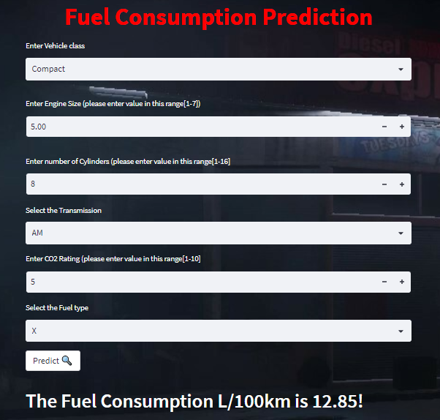
MODEL
Deployment
HomePage
After
Input
https://fuel-consumption-ratings.streamlit.app/#fuel-consumption-prediction

Slide 23








Challenges
4
3
Time Management
2
Model Deployment
1
Model Selection
Chi - Square Analysis
Notes:
https://storyset.com/amico

Slide 24
WHAT WE LEARNED
Team Work,
Pressure
Handling
ModeL
Deployment
CHI-SQUARE
ANALYSIS

Slide 25

Any Questions ?
We are open for questions & suggestions !

